Slide 1
Zomato Restaurant Insights Dashboard (Advanced Analysis)
By: Richin Stanly • Data Science • 12 PM Batch (May 2025)

Slide 2
Agenda
Dataset introduction
  Cleaning & transformation
  Country-level insights
  City-level insights
  Cuisine diversity analysis
  Rating behavior patterns
  Price psychology & spending habits
  Votes & engagement trends
  Correlation & advanced analytics
  Business recommendations
  Final conclusion

Slide 3
Dataset Overview
Total restaurants: 9551
  Countries covered: N/A
  Cities in dataset: 141
  Unique cuisines: 145
  Includes rating, price, votes, cuisines, locations

Slide 4
Data Cleaning Steps
Removed null values where required
  Split multi-value cuisine column
  Standardized text formatting
  Converted rating, votes & price to numeric
  Removed extreme outliers in price/votes

Slide 5
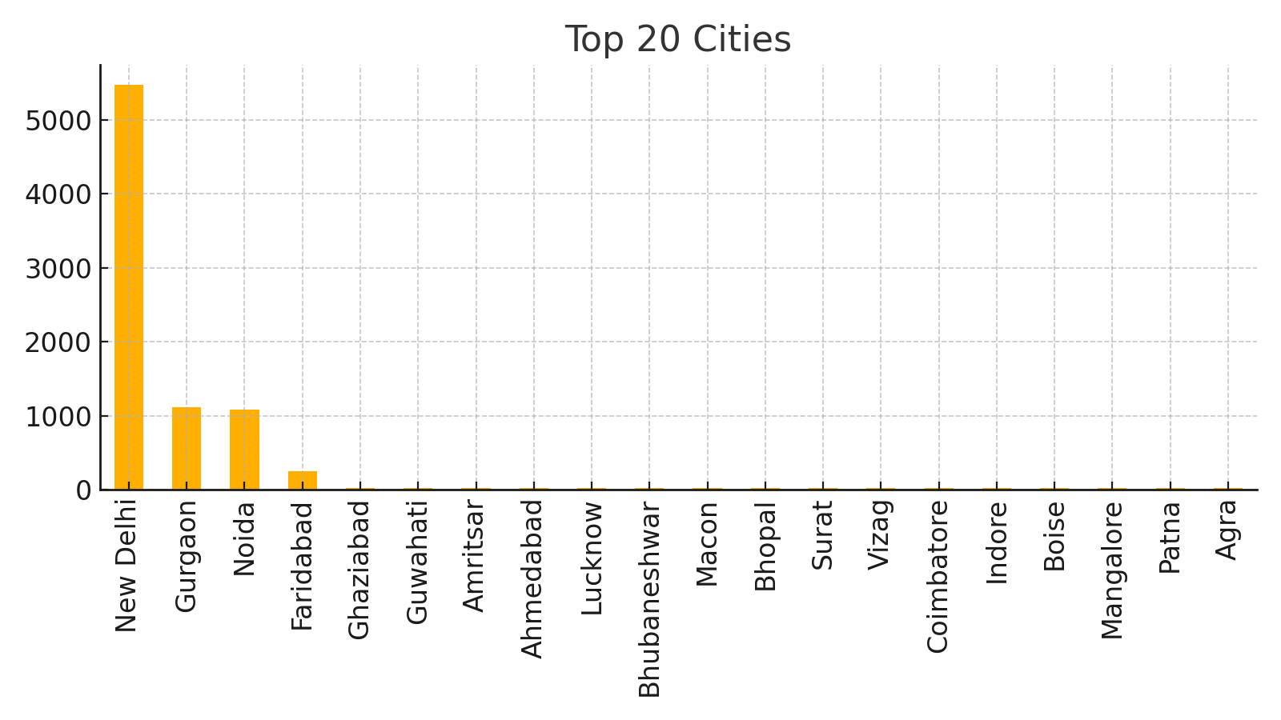
Top Cities

Slide 6
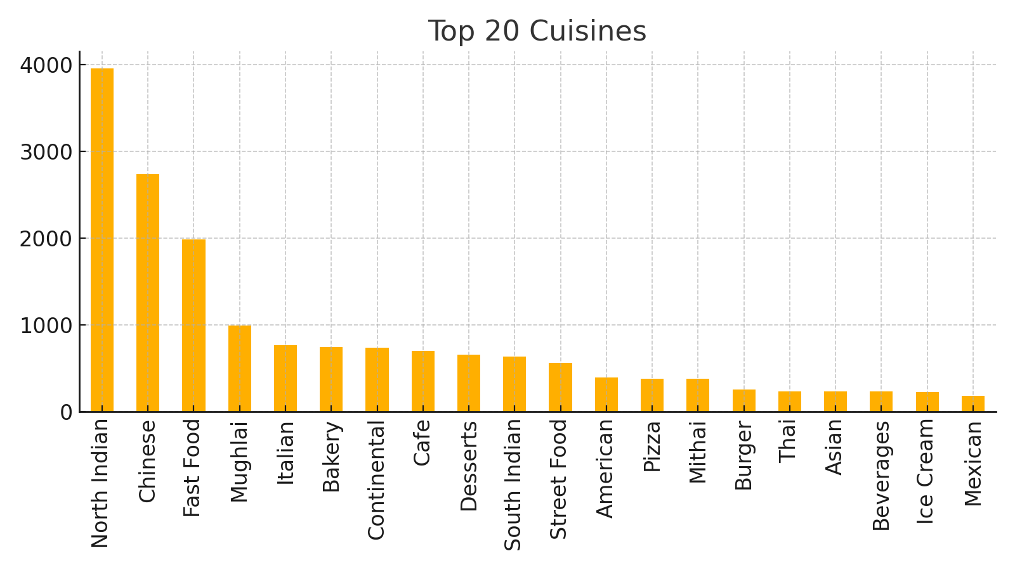
Top Cuisines

Slide 7
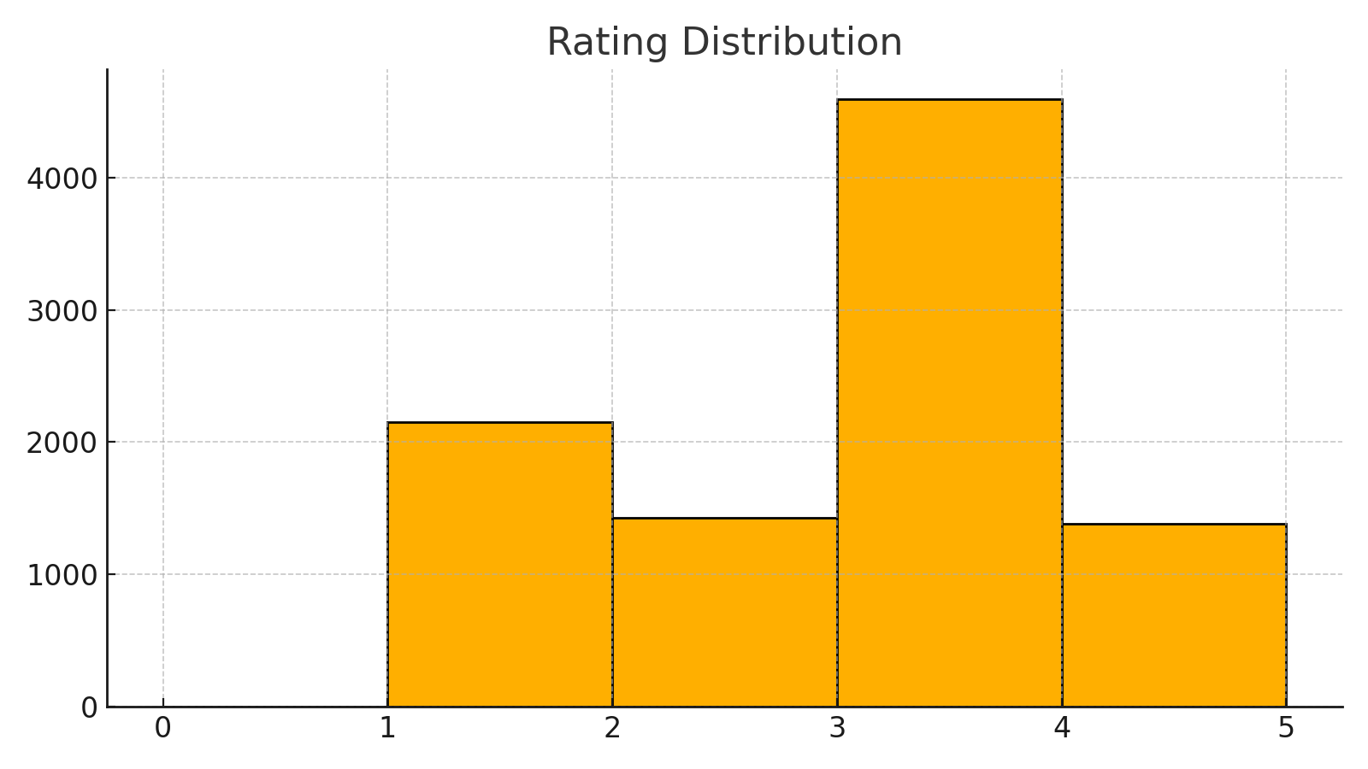
Rating Dist

Slide 8
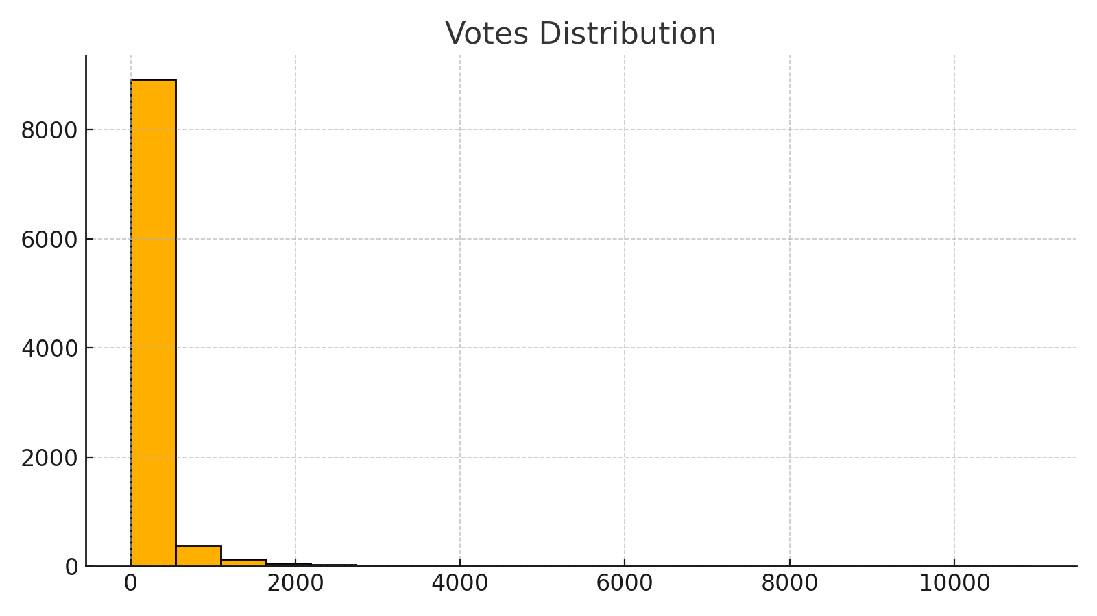
Votes Dist

Slide 9
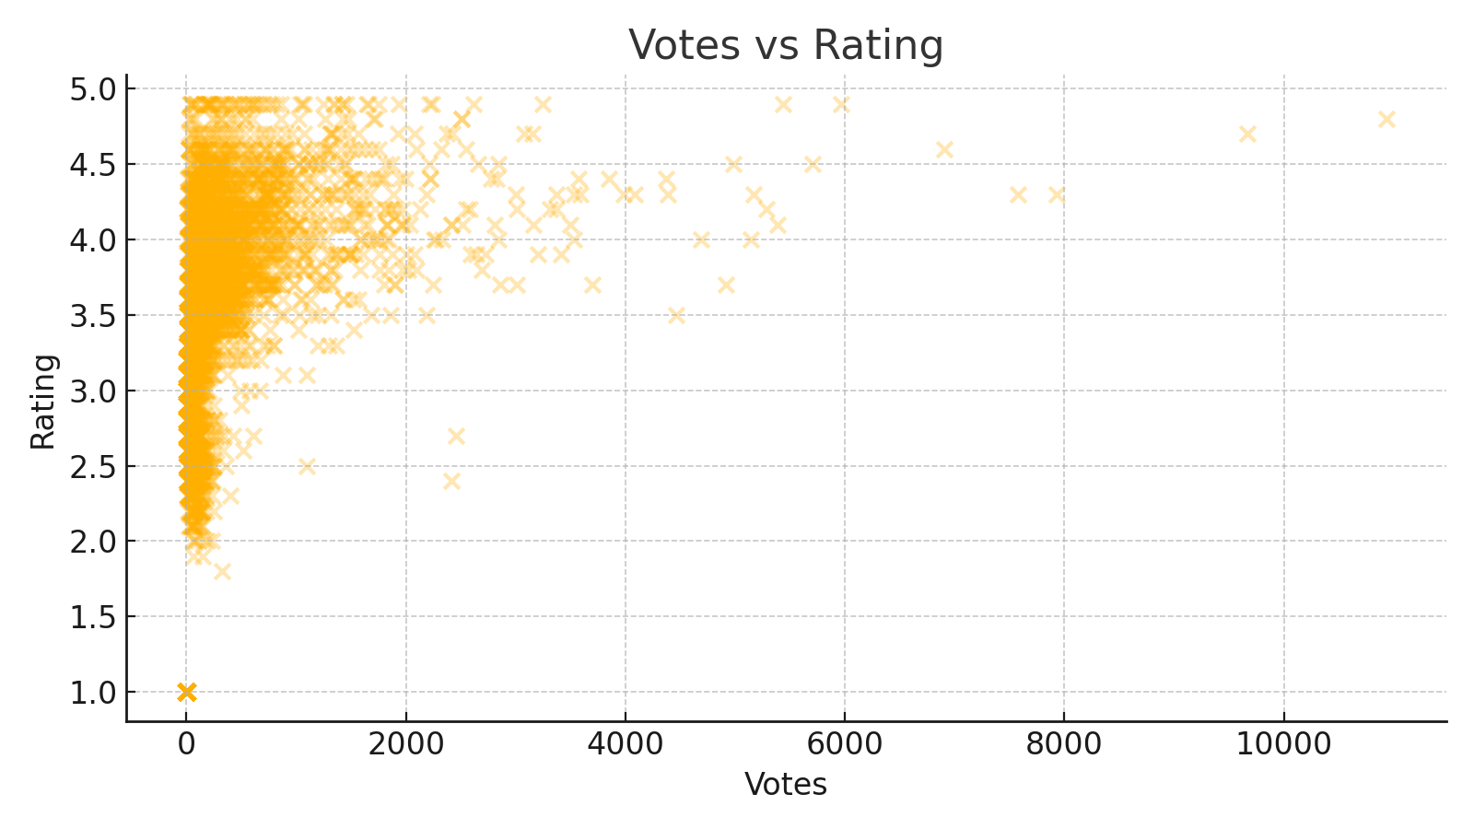
Votes Vs Rating

Slide 10
Key Insights – Ratings
Most restaurants are rated between 3.0 and 4.5
  Low-rated restaurants often have low votes or service issues
  High-priced restaurants maintain stable ratings

Slide 11
Key Insights – Price & Spending Patterns
Majority of customers prefer mid-range pricing
  Cost for two varies massively by country/city
  Budget restaurants dominate in high-density cities

Slide 12
Key Insights – Votes & Engagement
Votes strongly correlate with high ratings
  Restaurants with high engagement attract more customers
  Low voted restaurants struggle regardless of cuisine quality

Slide 13
Business Recommendations
Promote table booking for premium restaurants
  Encourage online delivery for high-density regions
  Introduce niche cuisines in metro cities
  Optimize pricing based on local spending behavior
  Improve online engagement (reviews, ratings, votes)

Slide 14
Conclusion
Zomato data reveals strong regional diversity
  Ratings & votes are critical business drivers
  Price strategy significantly impacts customer decisions
  Cities offer the largest market potential
  Overall, strong growth opportunities for targeted markets

